Slide 1
Insuchef
Meal Magicians / S2G7

Slide 2
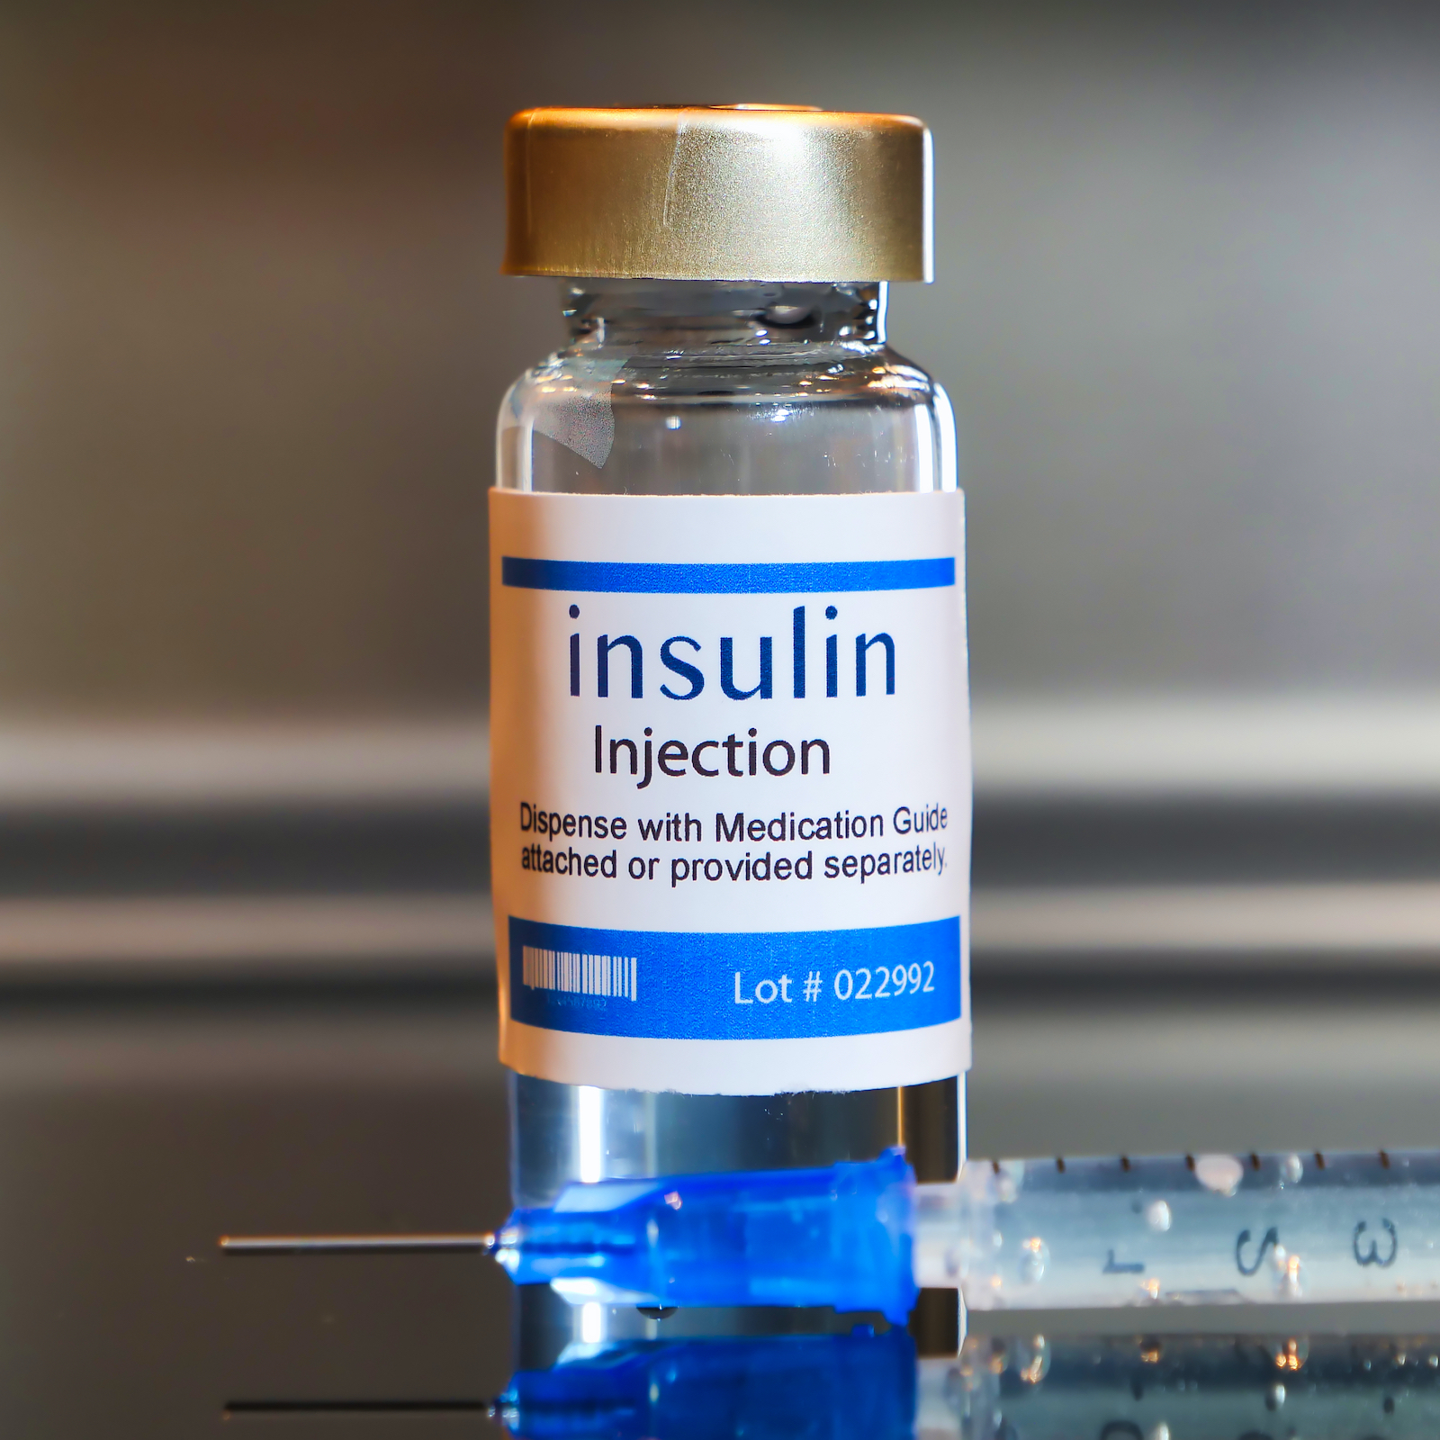
Introductıon
What ıs ınsuchef?
InsuChef is an app designed to make the lives of diabetic people who require insulin injections much easier.
The correct insulin dosage is often difficult to calculate, and it depends on different factors such as blood sugar levels, carbohydrate intake, insulin sensitivity factor and more.
InsuChef helps by tracking your carbohydrate intake and doing the necessary calculations to find the right amount of insulin for the patient.

Slide 3
WHy Insuchef ?
Why did we intend to do this project?
"In 2014, 8.5% of adults aged 18 years and older had diabetes. In 2019, diabetes was the direct cause of 1.5 million deaths, and 48% of all deaths due to diabetes occurred before the age of 70 years. Another 460 000 kidney disease deaths were caused by diabetes, and raised blood glucose causes around 20% of cardiovascular deaths " (1).
Although diabetes is a prevalent disease affecting millions, most people, even patients, don't have enough information about it.

Slide 4
Problems and Solutıons
1. Some patients inject more or less insulin than needed. Both cases are not optimum for the human body.
If there is more insulin than required, pancreas cells have to produce glucagon to balance the blood sugar. If there is less insulin than needed, the patient might suffer severe diseases, such as heart diseases and neurological diseases.
This application tries to prevent these problems by calculating the sufficient insulin dose for the patient.

Slide 5
Problems and solutıons
2. Other than injecting more or less insulin, some patients inject themselves with insulin at the wrong time.
The InsuChef application will create a message to notify users about when they should inject insulin.
3. Although insulin injection helps people with diabetes to maintain a healthy and standard life, patients must be careful about their consumption. However, some patients are careless about it.
InsuChef will help patients to keep their carbohydrate intake limited since it calculates their carbohydrate intake for each meal.

Slide 6
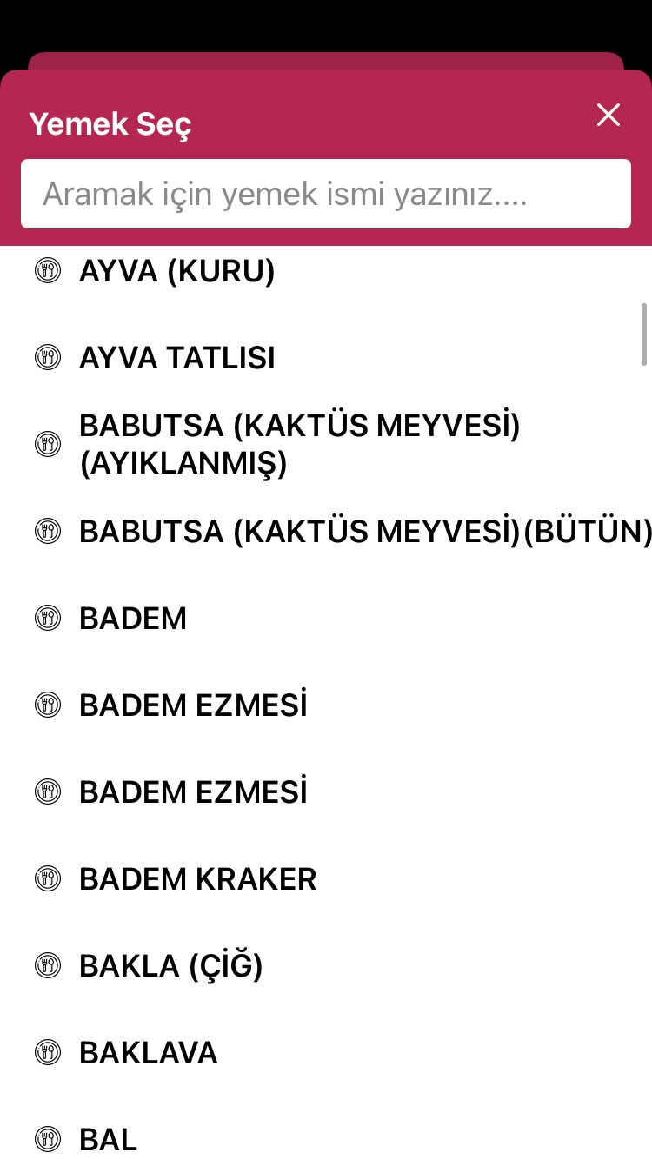
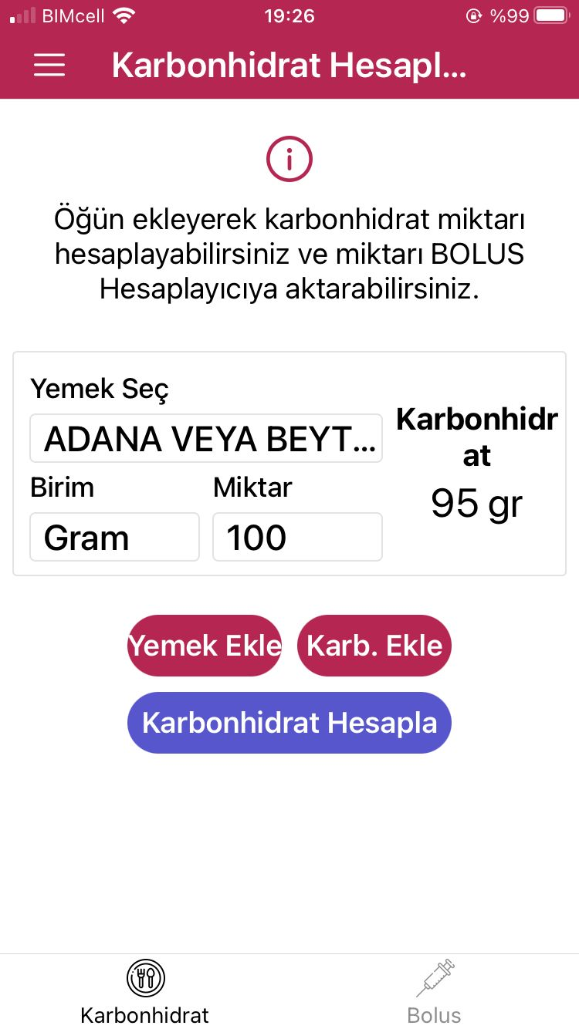
FEATURES
This diabetes management app features five screens, each with a unique function to help patients manage their diabetes.
The Profile Screen collects important patient information for calculations, such as weight, insulin to carbohydrate ratio, insulin sensitivity factor, and target blood sugar levels.
The Main Screen has buttons for updating patient information and accessing the Food List Screen, which displays food categories and frequently used items for meal planning.
(2)

Slide 7
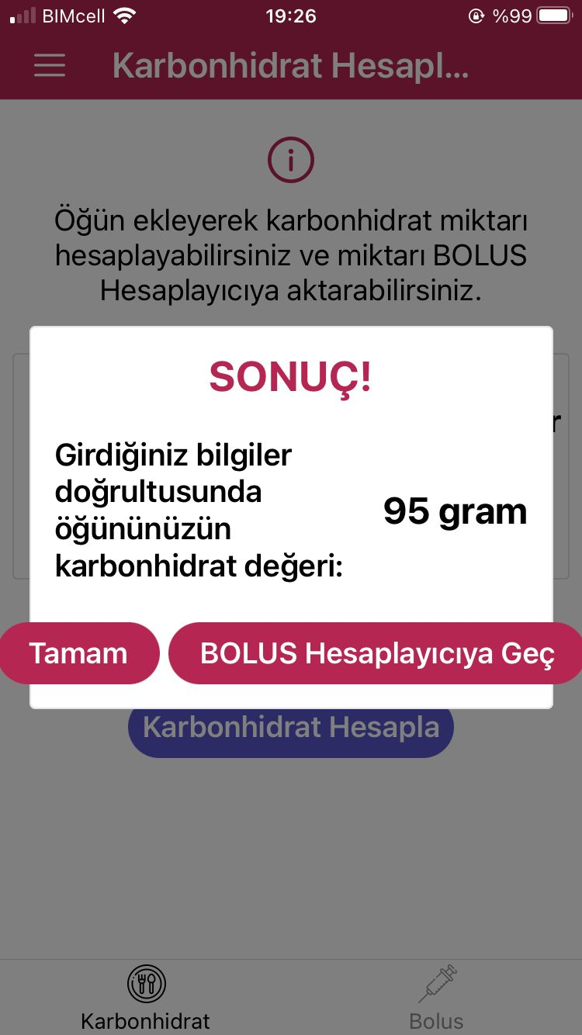
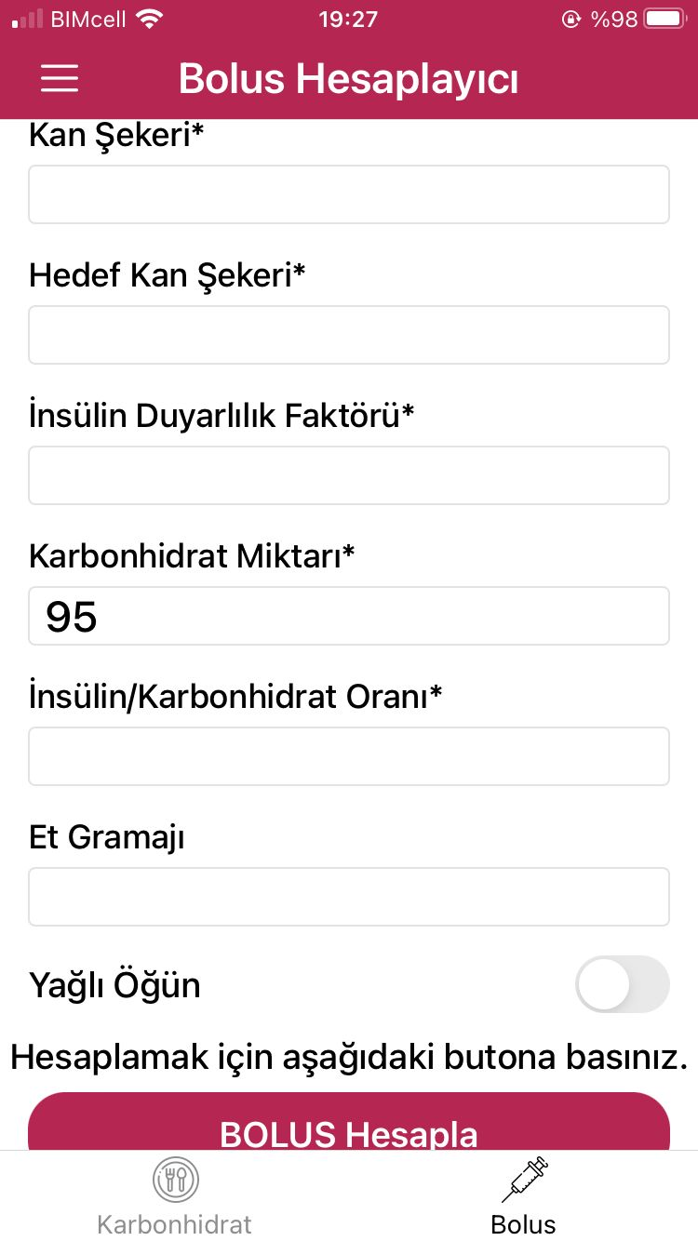
FEATURES
The Distribution Screen allows for customized meal planning or automatic adjustment of selected food items to stay within a predetermined total meal carbohydrate value.
The Insulin Calculation Screen calculates bolus insulin doses based on the patient's information and current blood sugar levels.
With these features, this app simplifies diabetes management for patients.
(2)

Slide 8


Technologies
To make this app we use two different technologies with java.
Data extraction from a database using API (Application Programming Interface)
Making interactive and simple user interface using Android Studio.

Slide 9
What is API and How Will we use iT
API is a tool that ones can extract data generally from a website or a database.
In our application we will use USDA FoodData Central website’s database which has enough data about common foods’ carbohydrate amount and nutrition value.
We will first get our API key which we will get from the website then by using this key we will request data from the database. After getting the data we will parse it in a file and store it.
In this way we always have data to process even without the internet connection and we don’t always need to send requests to the website and exceed the request limit.
USDA Food Database
API Key
Our Application
Reading
File
Parsing
Response

Slide 10

AnDRoid Studio and How Will We Use it
Our target audience must always calculate their carb counts and insulin amount, so the portability and accessibility of the insulin calculator are very important.
Some insulin calculators are web-based, but the lack of an internet connection may have a problem. Because of that, we want to make an android application.
For making the user interface of our application, we will use the android studio.

Slide 11


Exıstıng projects and ınnovatıons ın our project
Karbonhidrat-Bolus Hesaplayıcı (2)
mySugr- Diyabet Takip Günlüğü (3)
Diyabet Kontrol (4)
Even though the data collected from the user and the function of these apps are similar to our application InsuChef, we aim for a more straightforward interface since these apps’ interfaces are a bit complicated. We are also planning to make developments in the food list, such as limiting the total carbohydrate intake and warning the user about harmful nutrition.

Slide 12
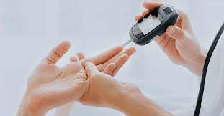
Target audıence
InsuChef is an application that designed for people with diabetes. But other than patients, people who want to keep track of their carbohydrate intake and keep it limited can also use InsuChef since one of its main features is to calculate the carbohydrate intake.

Slide 13

Conclusıon
In conclusion, InsuChef is a user-friendly app that helps diabetic people calculate their insulin dosages and track carbohydrate intake, making use of technologies like API keys and Android Studio.

Slide 14
Group members
EMİNE FİDAN
UMAY DÜNDAR
EDİP EMRE DÖNGER
ELİF ERCAN
YİĞİT KEMAL CAN

Slide 15
references
1. “Diabetes.” World Health Organization, World Health Organization, 16 Sept. 2022, https://www.who.int/news-room/fact-sheets/detail/diabetes.
2. https://play.google.com/store/apps/details?id=com.boluscalculator&hl=tr&gl=US
3. https://play.google.com/store/apps/details?id=com.mysugr.android.companion&hl=tr&gl=US
4. https://play.google.com/store/apps/details?id=melstudio.msugar&hl=tr&gl=US

